Slide 1
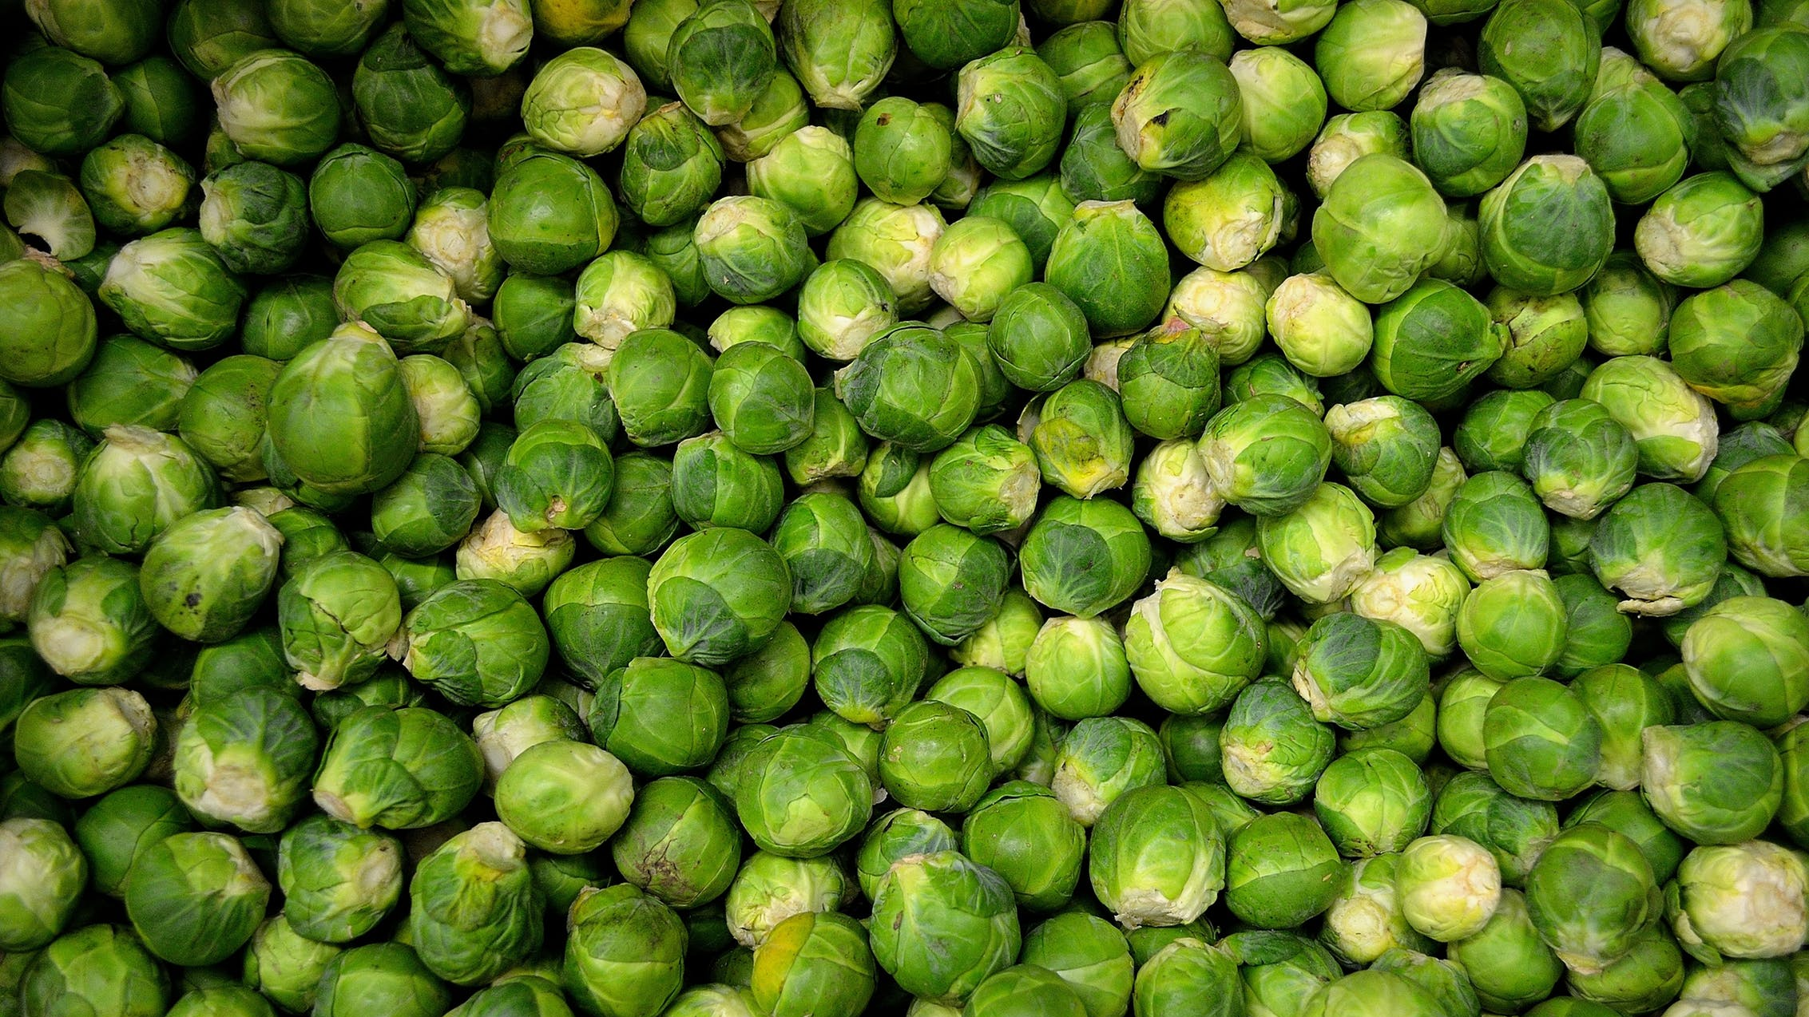

Turbocharge your API integration with Microsoft Kiota
#CollabDaysBE
Vincent Biret
CollabDays Belgium 2022 by BIWUG

Slide 3

Vincent Biret
Microsoft Graph Senior Software Developer
Lead developer for Microsoft Kiota
https://about.me/vincentbiret
Montréal 🍁

Slide 4
Agenda
Introduction
Kiota
Demo
Conclusion

Slide 5
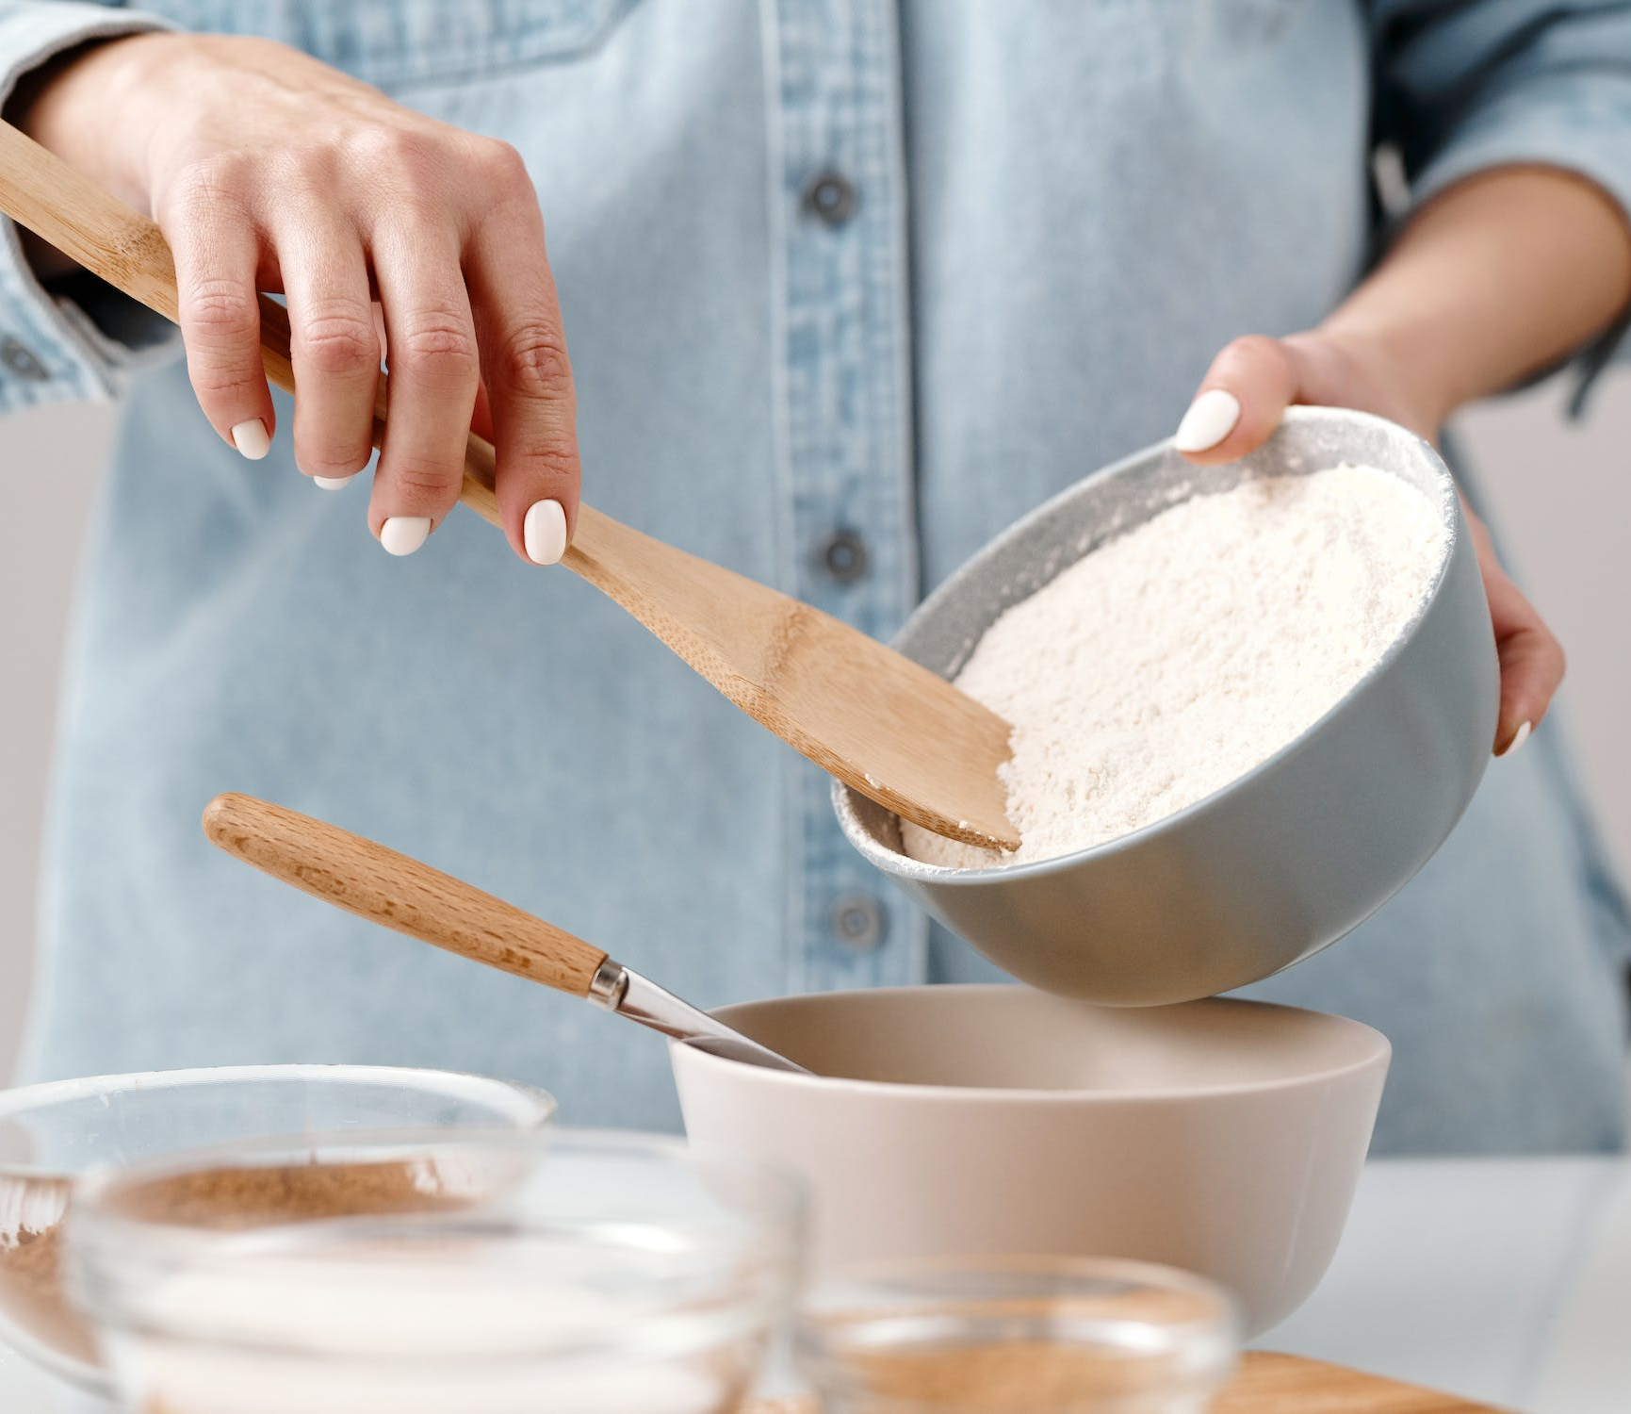
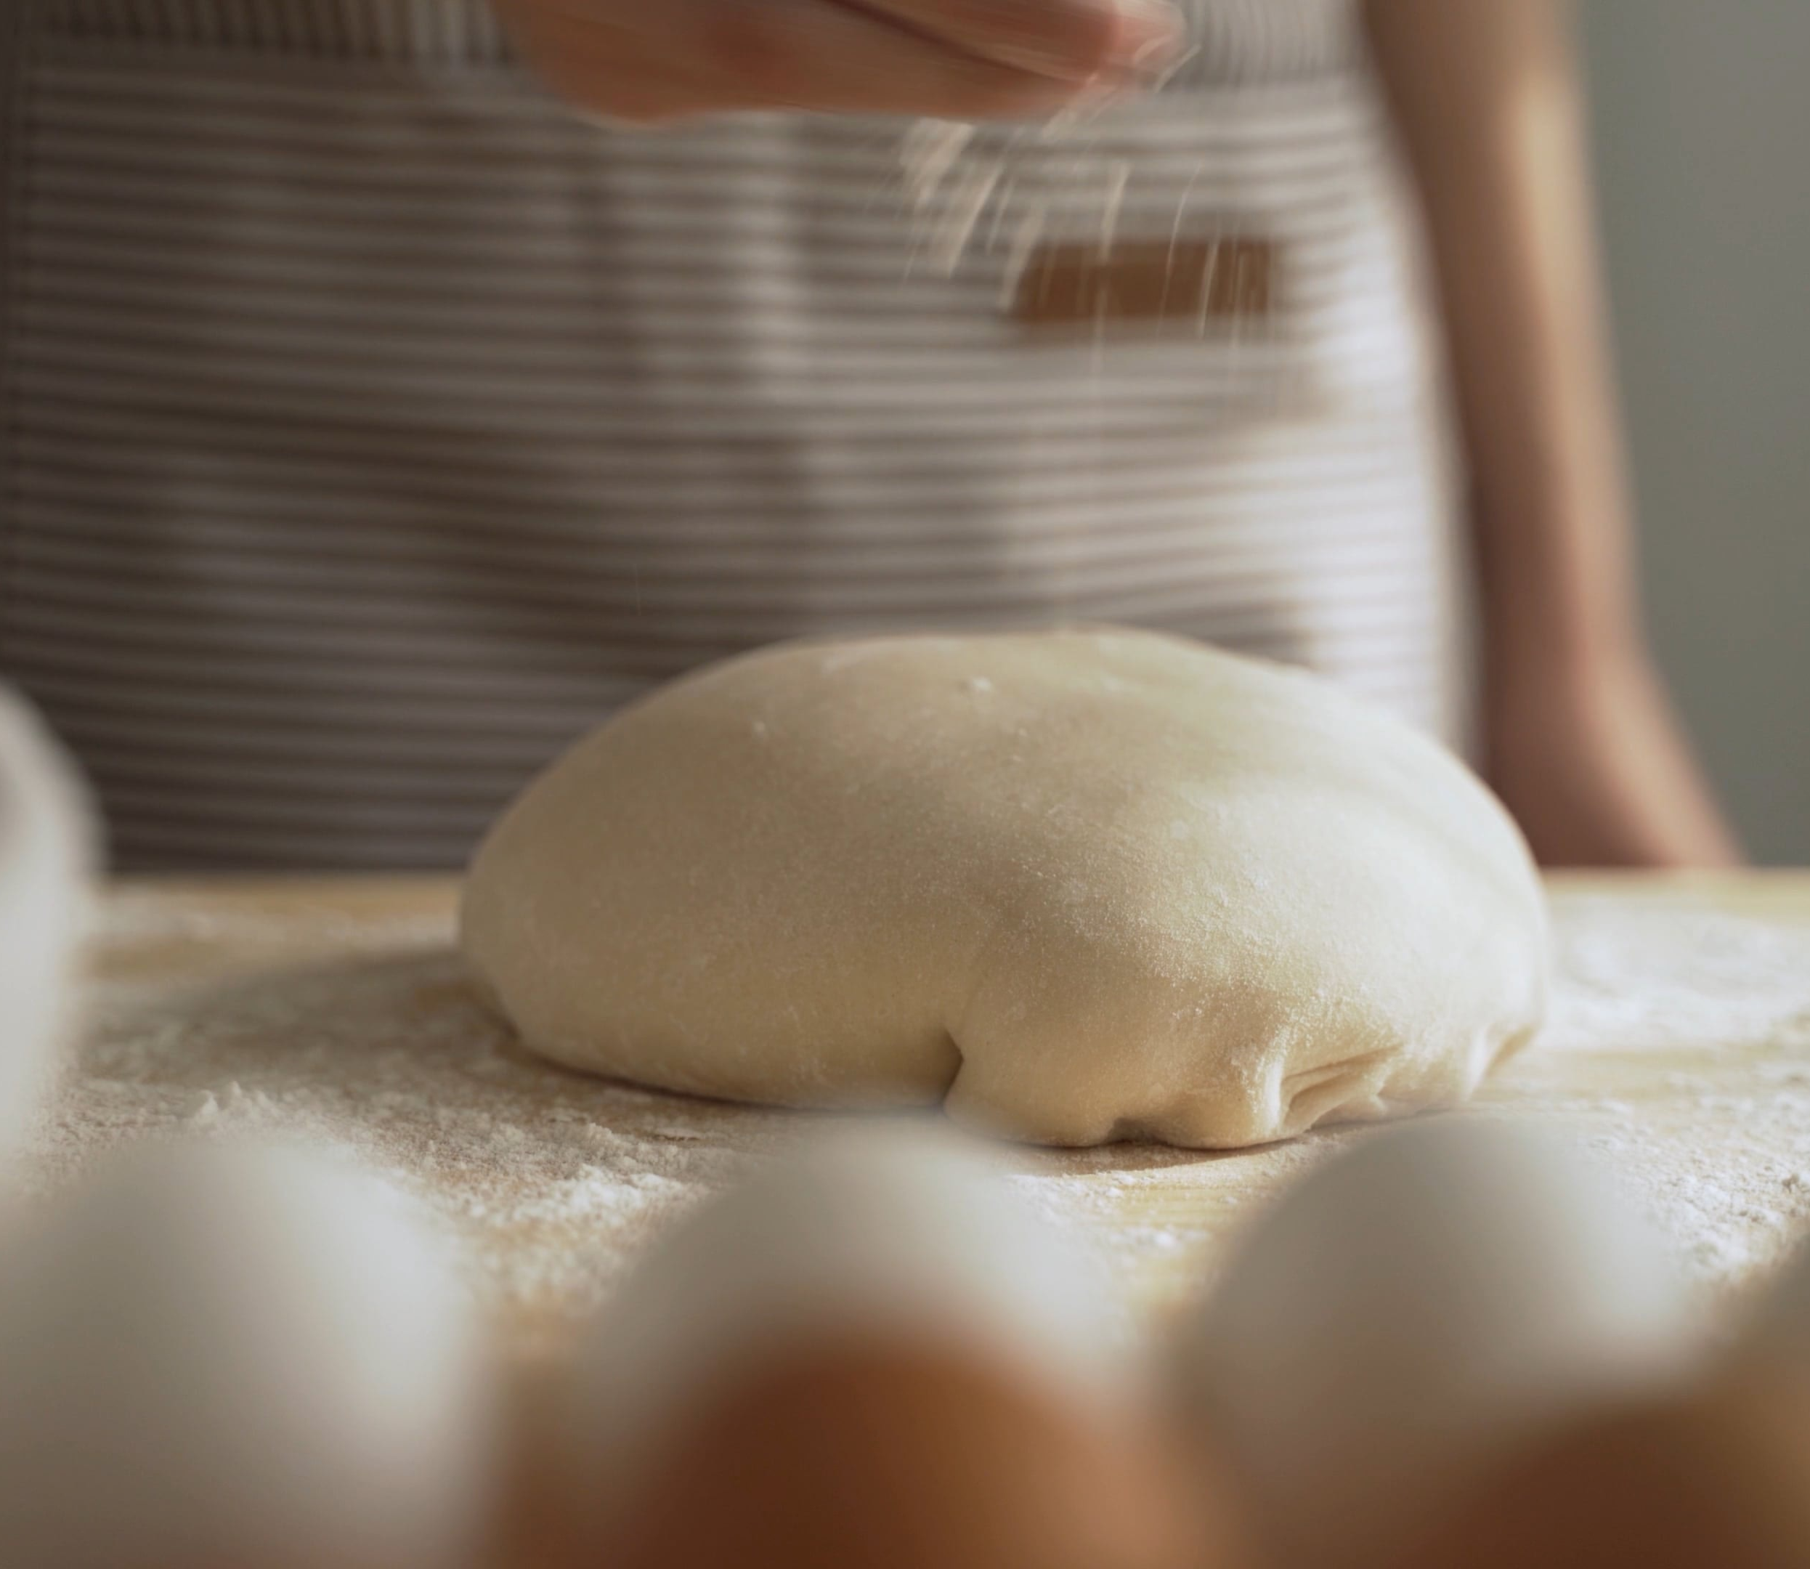
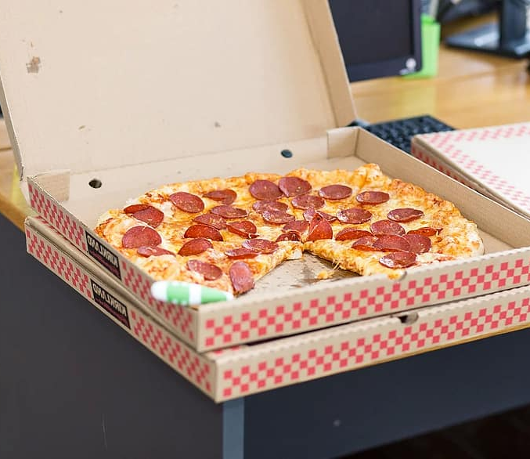

The Pizza Analogy for calling APIs
Native Client | Core client | Self-Served client | Packaged
Middleware | Middleware | Middleware | Middleware | Core
Authentication | Authentication | Authentication | Authentication
Models | Models | Models | Models | Service Library
Requests Factories | Requests Factories | Requests Factories | Requests Factories
Serialization | Serialization | Serialization | Serialization
Packaging | Packaging | Packaging | Packaging
From Scratch | Buy Pizza dough | Pick-up | Delivery
Notes:
In 2014 Albert Barron invented the analogy of Pizza as a service for cloud computing
It compares on-prem vs IAAS, PAAS, SAAS in terms of how you get your pizza.
It turns out, with a few tweaks, this analogy is helpful for explaining the different ways to call APIs and also our self-serve model
Native Client
Kiota Core (Our SDKs a split between core and service library)
Core is handwritten HTTP machinery that is not specific to any API
Service library is about making it easy to work with the concepts specific to the particular API
Self-serve is about picking your own toppings and letting Kiota generate that service library for you.
You just have ship the code yourself.
If you want the pizza delivered, we will still do that. We will generate the entire Graph API surface area and delivery it to your favourite package manager.
So, let’s talk more about what we are going to deliver…
Images from public domain
pexels-photo-6061574.jpeg (2250×1500) https://images.pexels.com/videos/7965416/pexels-photo-7965416.jpeg?cs=srgb&dl=pexels-felicity-tai-7965416.jpg&fm=jpg pizza-food-takeout-box-pepperoni-office-snack.jpg (880×586) (pikist.com) pexels-photo-4254135.jpeg (1125×750)

Slide 6
Why generate clients?
Models & serialization
Chained-style API to build requests
Standardizes the approach
Automates repetitive work
Better quality clients and applications

Slide 7
Microsoft Kiota
Open-source client generator for OpenAPI’s
Started in 2021
Public preview
Generates:
Models
Chained-style API
Notes:
Context: worked on a generator for OpenAPI and JSON Schema for 2 years. While the standards are great, they have shortcomings when it comes to generation and we should address them. Let’s start by reminding everybody that JSON Schema is a validation standard, not originally designed for generation.

Slide 8
Kiota in a nutshell
Creates clients that are:
Easy to use
Secure
Flexible
Resilient
Performant
What’s new?
Improved developer experience
More languages support
More support for API features
Self-serve experience
Kiota is a lightweight, low-maintenance OpenAPI-based code generator for quickly and easily creating clients for HTTP APIs.

Slide 9
Kiota flow
search
Find an API description
show
Explore the API paths
generate
Get a right sized client
Info
Get the dependencies
Fine tune filters
Display its details

Slide 10
Demo
Creating To-Do tasks for GitHub pull requests

Slide 11
Conclusion

Slide 12
Roadmap
Microsoft Graph
Integration in Graph Explorer
Metadata fixes (models trim)
General availability of kiota based SDKs
Kiota
General availability of existing languages
More languages support
General availability of Kiota

Slide 13
Call to actions
Try out
Kiota
Documentation https://microsoft.github.io/kiota
Repository https://github.com/microsoft/kiota
Try out
Our next generation SDKs
https://github.com/microsoftgraph
Give
us feedback!

Slide 14

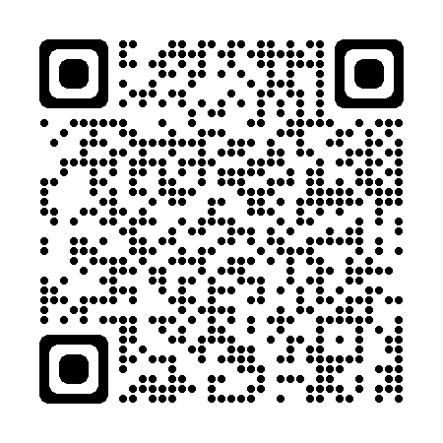
https://collabdays.be
Please rate this session and have a chance to win an awesome prize
#CollabDaysBE

Slide 15

#CollabDaysBE

